Slide 1
Activity& Intent
Kai Qian

Slide 2
Understand Android applications and their components
activity
service
broadcast receiver
content provider
intent
AndroidManifest.xml

Slide 3
Android Application
Written in Java (it’s possible to write native code) Good separation (and corresponding security) from other applications:
Each application runs in its own process
Each process has its own separate VM
Each application is assigned a unique Linux user ID – by default files of that application are only visible to that application (can be explicitly exported)

Slide 4
Components
Activities – visual user interface focused on a single thing a user can do
Services – no visual interface – they run in the background
Broadcast Receivers – receive and react to broadcast announcements
Content Providers – allow data exchange between applications

Slide 5
Activities
Basic component of most applications
Most applications have several activities that start each other as needed
Each is implemented as a subclass of the base Activity class

Slide 6
Activities – The View
Each activity has a default window to draw in (although it may prompt for dialogs or notifications)
The content of the window is a view or a group of views (derived from View or ViewGroup)
Example of views: buttons, text fields, scroll bars, menu items, check boxes, etc.
View(Group) made visible via Activity.setContentView() method

Slide 7
Activity state
State Description
Running Activity is visible and interacts with the user.
Paused Activity is still visible but partially obscured, instance is running but might be killed by the system.
Stopped Activity is not visible, instance is running but might be killed by the system.
Killed Activity has been terminated by the system of by a call to its finish() method.
The user should not notice if an activity which is still part of an activity stack has been terminate or not. For this the developer needs to store the state of the activity at the right point in time and restore it. He also should stop any unnecessary actions if the activity is not visible anymore to save system resources.
The Android system defines a lifecycle for activities via predefined (lifecycle) methods. The most important methods are:

Slide 8
Important Activity lifecycle methods
onCreate() Called then the activity is created. Used to initialize the activity, for example create the user interface.
onResume() Called if the activity get visible again and the user starts interacting with the activity again. Used to initialize fields, register listeners, bind to services, etc.
onPause() Called once another activity gets into the foreground. Always called before the activity is not visible anymore. Used to release resources or save application data. For example you unregister listeners, intent receivers, unbind from services or remove system service listeners.
onStop() Called once the activity is no longer visible. Time or CPU intensive shut-down operations, such as writing information to a database should be down in the onStop() method.

Slide 9
Activity instance state
Instance state of an activity which is required to restore the activity to the state in which the user left it.
Assume for example the user scrolled through a ListView with thousands of items and the activity is recreated. Loosing the position in the list is annoying for the user, hence the position should be restored.
The onSaveInstanceState() can be used to store this instance state as a Bundle. A Bundle can contain primitive data types, arrays, String and objects which are of the Parcelable or Serialisable type.
The persisted Bundle data is passed at restart of the activity to the onCreate() method and onRestoreInstanceState() as parameter.
The onRestoreInstanceState() or the onCreate() methods can be used to recreate the instance scope of an activity if it is restarted.

Slide 10
Understand the Lifecycle Callbacks of Activity
Instead of starting a program with a main() method, the Android system initiates code in an Activity instance by invoking specific callback methods that correspond to specific stages of its lifecycle. There is a sequence of callback methods that start up an activity and a sequence of callback methods in a step pyramid. That is, each stage of the activity lifecycle is a separate step on the pyramid.
As the system creates a new activity instance, each callback method moves the activity state one step toward the top. The top of the pyramid is the point at which the activity is running in the foreground and the user can interact with it.
As the user begins to leave the activity, the system calls other methods that move the activity state back down the pyramid in order to dismantle the activity. In some cases, the activity will move only part way down the pyramid and wait (such as when the user switches to another app), from which point the activity can move back to the top (if the user returns to the activity) and resume where the user left off.

Slide 11
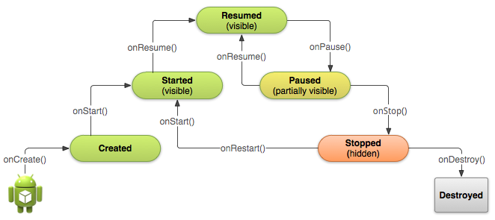

Slide 12
This shows how, for every callback used to take the activity a step toward the Resumed state at the top, there's a callback method that takes the activity a step down. The activity can also return to the resumed state from the Paused and Stopped state.
Depending on the complexity of your activity, you probably don't need to implement all the lifecycle methods.
only three states can be static. That is, the activity can exist in one of only three states for an extended period of time:

Slide 13
The other states (Created and Started) are transient and the system quickly moves from them to the next state by calling the next lifecycle callback method. That is, after the system calls onCreate(), it quickly calls onStart(), which is quickly followed by onResume().

Slide 14
If the user interacts with an activity and presses the Back button or if the finish() method of an activity is called, the activity is removed from the current activity stack and recycled. In this case there is no instance state to save and the onSaveInstanceState() method is not called.
If the user interacts with an activity and presses the Home button, the activity instance state must be saved. The onSaveInstanceState() method is called. If the user restarts the application it will resume or restart the last running activity. If it restarts the activity it provides the bundle with the save data to the onRestoreInstanceState() and onCreate() methods.

Slide 15
Specify Your App's Launcher Activity
When the user selects your app icon from the Home screen, the system calls the onCreate() method for the Activity in your app that you've declared to be the "launcher" (or "main") activity. This is the activity that serves as the main entry point to your app's user interface.
You can define which activity to use as the main activity in the Android manifest file, AndroidManifest.xml, which is at the root of your project directory.
The main activity for your app must be declared in the manifest with an <intent-filter> that includes the MAIN action and LAUNCHER category. For example:

Slide 16
Manifest with this filter
<activity android:name=".MainActivity" android:label="@string/app_name">
<intent-filter>
<action android:name="android.intent.action.MAIN" />
<category android:name="android.intent.category.LAUNCHER" />
</intent-filter>
</activity>
If either the MAIN action or LAUNCHER category are not declared for one of your activities, then your app icon will not appear in the Home screen's list of apps.

Slide 17
Create a New Instance
Most apps include several different activities that allow the user to perform different actions. Whether an activity is the main activity that's created when the user clicks your app icon or a different activity that your app starts in response to a user action, the system creates every new instance of Activity by calling its onCreate() method.
You must implement the onCreate() method to perform basic application startup logic that should happen only once for the entire life of the activity. For example, your implementation of onCreate() should define the user interface and possibly instantiate some class-scope variables.

Slide 18
the onCreate() method
It performs some fundamental setup for the activity, such as declaring the user interface (defined in an XML layout file), defining member variables, and configuring some of the UI.
TextView mTextView; // Member variable for text view in the layout
@Override
public void onCreate(Bundle savedInstanceState) {
super.onCreate(savedInstanceState);
// Set the user interface layout for this Activity
// The layout file is defined in the project res/layout/main_activity.xml file
setContentView(R.layout.main_activity);
// Initialize member TextView so we can manipulate it later
mTextView = (TextView) findViewById(R.id.text_message);
ActionBar actionBar = getActionBar();
actionBar.setHomeButtonEnabled(false);
}
}

Slide 19
Once the onCreate() finishes execution, the system calls the onStart() and onResume() methods in quick succession. Your activity never resides in the Created or Started states. Technically, the activity becomes visible to the user when onStart() is called, but onResume() quickly follows and the activity remains in the Resumed state until something occurs to change that, such as when a phone call is received, the user navigates to another activity, or the device screen turns off.
Once this callback sequence of onCreate(), onStart(), and onResume() complete, the activity reaches the Resumed state where users can interact with the activity until they switch to a different activity.

Slide 20
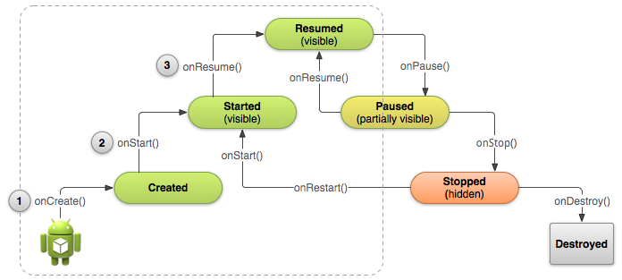

Slide 21
Destroy the Activity
While the activity's first lifecycle callback is onCreate(), its very last callback is onDestroy(). The system calls this method on your activity as the final signal that your activity instance is being completely removed from the system memory.
Most apps don't need to implement this method because local class references are destroyed with the activity and your activity should perform most cleanup during onPause() and onStop(). However, if your activity includes background threads that you created during onCreate() or other long-running resources that could potentially leak memory if not properly closed, you should kill them during onDestroy().
@Override
public void onDestroy() {
super.onDestroy(); // Always call the superclass
// Stop method tracing that the activity started during onCreate()
android.os.Debug.stopMethodTracing()

Slide 22
Demo
https://sites.google.com/site/mobilesecuritylabware/home/android-components/activity-intent

Slide 23
An Intent is sent to the Android OS system and the Android system will decide which target (for implicit intent) can do the job best. An Intent can also contain data. This data can be used by the receiving component. An explicit intent tells Android system to run specific component such as ActivityB Intent intent = new Intent(ActivityA.this, ActivityB.class); startActivity(intent);

Slide 24
An implicit intent tells Android system to run an activity(ActivityB in this case) that can do these things that are specified in the intent filter in a manifest . Intent intent = new Intent(); intent.addAction("thisAction"); intent.addCategory("thisCategory"); startActivity(intent);
the Android manifest file: <activity android:name="ActivityB"> <intent-filter> <action android:name="thisAction"/> <category android:name="thisCategory"/> </intent-filter> </activity>

Slide 25
Android system will locate a best matched component such as ActivityB based on action and category requirement. Implicit intent also leaves a security vulnerability hole.
Here is a simple intent demo app.
Activity A has a button with a caption of "Invoke B" and activity B will display "Hello Activity A". A don't display any and B does not have button.
Copy and Paste following code into specific files.

Slide 26
AndroidManifest.xml
<?xml version="1.0" encoding="utf-8"?> <manifest xmlns:android="http://schemas.android.com/apk/res/android" package="android.intent" android:versionCode="1" android:versionName="1.0"> <uses-sdk android:minSdkVersion="8" />
<application android:icon="@drawable/icon" android:label="@string/app_name"> <activity android:name=".Activityb" android:theme="@android:style/Theme.NoTitleBar" /> <activity android:name=".IntentActivity" android:label="@string/app_name"> <intent-filter> <action android:name="android.intent.action.MAIN" /> <category android:name="android.intent.category.LAUNCHER" /> </intent-filter> </activity>
</application> </manifest>

Slide 27
main.xml
<?xml version="1.0" encoding="utf-8"?> <LinearLayout xmlns:android="http://schemas.android.com/apk/res/android" android:orientation="vertical" android:layout_width="fill_parent" android:layout_height="fill_parent" > <Button android:id="@+id/button1" android:layout_width="wrap_content"
android:layout_height="wrap_content" android:text="Invoke B"></Button> </LinearLayout>

Slide 28
activityb.xml
<?xml version="1.0" encoding="utf-8"?> <LinearLayout xmlns:android="http://schemas.android.com/apk/res/android" android:orientation="vertical" android:layout_width="match_parent" android:layout_height="match_parent"> <TextView android:id="@+id/textView1"
android:layout_height="wrap_content" android:layout_width="wrap_content“
android:textAppearance="?android:attr/textAppearanceLarge"
android:text="Hello Activity A">
</TextView> </LinearLayout>

Slide 29
intentActivity.java
package android.intent;
import android.app.Activity; import android.content.Context; import android.content.Intent; import android.os.Bundle; import android.view.View; import android.view.View.OnClickListener; import android.widget.Button;
public class IntentActivity extends Activity { /** Called when the activity is first created. */ @Override public void onCreate(Bundle savedInstanceState) { final Context context = this; super.onCreate(savedInstanceState); setContentView(R.layout.main); final Button invoke=(Button)findViewById(R.id.button1);
Continue…

Slide 30
invoke.setOnClickListener(new OnClickListener() { public void onClick(View v) { Intent intent = new Intent(context, Activityb.class); startActivity(intent); } }); } }

Slide 31
Activityb.java
package android.intent;
import android.app.Activity; import android.os.Bundle;
public class Activityb extends Activity { public void onCreate(Bundle savedInstanceState) { super.onCreate(savedInstanceState); setContentView(R.layout.activityb); } }

Slide 32
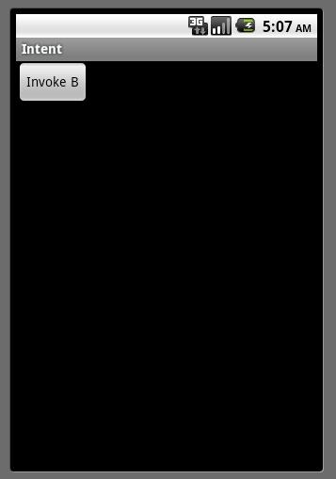
Demo
After all, save and run this app.
The first activity only has a button named Invoke B. Click it.

Slide 33
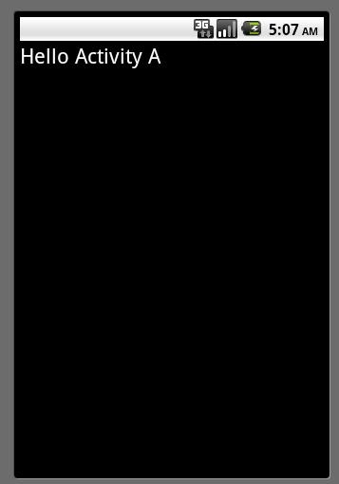
Then the Activity B with text "Hello Activity A" is presented.

Slide 34
There is another example shows more about the usage of implicit intent.
In implicit intents, we do not name a specific component, but instead declare a general action to perform, which allows a component from another app to handle it. For example, if you want to show the user a location on a map, you can use an implicit intent to request that another capable app to show a specified location on a map.
When using an implicit intent, it is the Andriod system that will find the appropriate component to start by comparing the contents of the intent to the intent-filters declared in the manifest file of the other apps on the device. If the intent matches an intent filter, the system starts that component and delivers it the Intent object. If multiple intent filters are compatible, the system displays a dialog so the user can pick which app to use. One of the example can be showed as below:

Slide 35
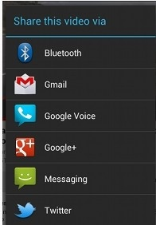
We have a video that we want to share with others, we may have multiple choice:

Slide 36
Caution: It's possible that a user won't have any apps that handle the implicit intent you send to startActivity(). If that happens, the call will fail and your app will crash. To verify that an activity will receive the intent, call resolveActivity() on your Intent object. If the result is non-null, then there is at least one app that can handle the intent and it's safe to call startActivity(). If the result is null, you should not use the intent and, if possible, you should disable the feature that issues the intent.
For practice and simplicity, in our lab, we have only one application and multiple activities to show how the intent-filter can be matched.
The following activity is the one that would be displayed in the screen when the app is started.

Slide 37
ImplicitIntentActivity.java
package android.implicitintent;
import android.net.Uri;
import android.os.Bundle;
import android.app.Activity;
import android.content.Intent;
import android.view.Menu;
import android.view.View;
import android.view.View.OnClickListener;
import android.widget.Button;
import android.widget.Toast;
public class ImplicitIntentActivity extends Activity {
@Override
protected void onCreate(Bundle savedInstanceState) {
super.onCreate(savedInstanceState);
setContentView(R.layout.main);
Continue…

Slide 38
Button btnA=(Button) findViewById(R.id.button1);
btnA.setOnClickListener(new OnClickListener(){
@Override
public void onClick(View v) {
//set implicit intent to match activity A
Intent intent=new Intent();
//set action
intent.setAction("com.wyou.action");
//set category
intent.addCategory("com.wyou.category");
//set data
intent.setData(Uri.parse("wyou://www.wyou.com/wyou"));
if (intent.resolveActivity(getPackageManager()) != null) {
startActivity(intent);
}
else{
Toast toast=Toast.makeText(getApplicationContext(), "No Activity is matched!", Toast.LENGTH_SHORT);
toast.show();
}
}});
Continue…

Slide 39
Button btnB=(Button) findViewById(R.id.button2);
btnB.setOnClickListener(new OnClickListener(){
@Override
public void onClick(View v) {
//set implicit intent to match activity B
intent=new Intent();
//set action
intent.setAction("com.wyou.actionB");
//set category
intent.addCategory("com.wyou.categoryB");
//set data
intent.setData(Uri.parse("wyou://www.wyou.com/wyou"));
if (intent.resolveActivity(getPackageManager()) != null) {
startActivity(intent);
}
else{
Toast toast=Toast.makeText(getApplicationContext(), "No Activity is matched!", Toast.LENGTH_SHORT);
toast.show();
}
}});
Continue…

Slide 40
Button btnA=(Button) findViewById(R.id.button1);
btnA.setOnClickListener(new OnClickListener(){
@Override
public void onClick(View v) {
//set implicit intent to match activity A
Intent intent=new Intent();
//set action
intent.setAction("com.wyou.action");
//set category
intent.addCategory("com.wyou.category");
//set data
intent.setData(Uri.parse("wyou://www.wyou.com/wyou"));
if (intent.resolveActivity(getPackageManager()) != null) {
startActivity(intent);
}
else{
Toast toast=Toast.makeText(getApplicationContext(), "No Activity is matched!", Toast.LENGTH_SHORT);
toast.show();
}
}});
Continue…

Slide 41
Button btnC=(Button) findViewById(R.id.button3);
btnC.setOnClickListener(new OnClickListener(){
@Override
public void onClick(View v) {
//set implicit intent to match activity C
Intent intent=new Intent();
//set action
intent.setAction("com.wyou.action");
//set category
intent.addCategory("com.wyou.category");
//set data to match "text/*", so this intent will invoke ActivityC
intent.setDataAndType(Uri.parse("wyou://www.wyou.com/wyou"), "text/plain");
if (intent.resolveActivity(getPackageManager()) != null) {
startActivity(intent);
}
else{
Toast toast=Toast.makeText(getApplicationContext(), "No Activity is matched!", Toast.LENGTH_SHORT);
toast.show();
}
}});
}
Continue…

Slide 42
@Override
public boolean onCreateOptionsMenu(Menu menu) {
// Inflate the menu; this adds items to the action bar if it is present.
getMenuInflater().inflate(R.menu.implicit_intent, menu);
return true;
}
}

Slide 43
main.xml
<RelativeLayout xmlns:android="http://schemas.android.com/apk/res/android"
xmlns:tools="http://schemas.android.com/tools"
android:layout_width="match_parent"
android:layout_height="match_parent"
android:paddingBottom="@dimen/activity_vertical_margin"
android:paddingLeft="@dimen/activity_horizontal_margin"
android:paddingRight="@dimen/activity_horizontal_margin"
android:paddingTop="@dimen/activity_vertical_margin"
tools:context=".ImplicitIntentActivity" >
<TextView
android:id="@+id/textView1"
android:layout_width="wrap_content"
android:layout_height="wrap_content"
android:text="@string/title"
android:textSize="25sp"
/>
Continue…

Slide 44
<Button
android:id="@+id/button1"
android:layout_width="wrap_content"
android:layout_height="wrap_content"
android:layout_alignLeft="@+id/textView1"
android:layout_below="@+id/textView1"
android:layout_marginTop="64dp"
android:text="@string/matchA" />
<Button
android:id="@+id/button2"
android:layout_width="wrap_content"
android:layout_height="wrap_content"
android:layout_alignLeft="@+id/button1"
android:layout_centerVertical="true"
android:text="@string/matchB" />
Continue…

Slide 45
<Button
android:id="@+id/button3"
android:layout_width="wrap_content"
android:layout_height="wrap_content"
android:layout_alignLeft="@+id/button2"
android:layout_below="@+id/button2"
android:layout_marginTop="49dp"
android:text="@string/matchC" />
</RelativeLayout>

Slide 46
strings.xml
<?xml version="1.0" encoding="utf-8"?>
<resources>
<string name="app_name">ImplicitIntent</string>
<string name="action_settings">Settings</string>
<string name="title">Implicit Intent Demo</string>
<string name="matchA">Single Activity Matched</string>
<string name="matchB">Multiple Activities Matched</string>
<string name="matchC">No Activity Matched</string>
<string name="a">Hi, I am activity A.</string>
<string name="b">Hi, I am actibity B.</string>
<string name="c">Hi, I am actibity C.</string>
<string name="back">Back</string>
</resources>

Slide 47
AndroidManifest.xml
<?xml version="1.0" encoding="utf-8"?>
<manifest xmlns:android="http://schemas.android.com/apk/res/android"
package="android.implicitintent"
android:versionCode="1"
android:versionName="1.0" >
<uses-sdk
android:minSdkVersion="8"
android:targetSdkVersion="18" />
<application
android:allowBackup="true"
android:icon="@drawable/ic_launcher"
android:label="@string/app_name"
android:theme="@style/AppTheme" >
<activity
android:name="android.implicitintent.ImplicitIntentActivity"
android:label="@string/app_name" >
Continue…

Slide 48
<intent-fi <intent-filter>ter>
<action android:name="android.intent.action.MAIN" />
<category android:name="android.intent.category.LAUNCHER" />
</intent-filter>
</activity>
<!-- ActivityA -->
<activity
android:name="android.implicitintent.ActivityA"
android:label="@string/app_name" >
<intent-filter>
<action android:name="com.wyou.action" />
<category android:name="android.intent.category.DEFAULT" />
<category android:name="com.wyou.category" />
Continue…

Slide 49
<data
android:host="www.wyou.com"
android:scheme="wyou" />
</intent-filter>
</activity>
<!-- ActivityB -->
<activity
android:name="android.implicitintent.ActivityB"
android:label="@string/app_name" >
<intent-filter>
<action android:name="com.wyou.actionB" />
<category android:name="android.intent.category.DEFAULT" />
<category android:name="com.wyou.categoryB" />
Continue…

Slide 50
<data
android:host="www.wyou.com"
android:scheme="wyou" />
</intent-filter>
</activity>
<!-- ActivityC -->
<activity
android:name="android.implicitintent.ActivityC"
android:label="@string/app_name" >
<intent-filter>
<action android:name="com.wyou.actionB" />
<category android:name="android.intent.category.DEFAULT" />
<category android:name="com.wyou.categoryB" />
<data
android:host="www.wyou.com"
android:scheme="wyou" />
</intent-filter>
</activity>
</application>
</manifest>

Slide 51
Each intent filter is defined by an <intent-filter> element in the app's manifest file, nested in the corresponding app component (such as an <activity> element). Inside the <intent-filter>, you can specify the type of intents to accept using one or more of these three elements:

Slide 52
<action>
Declares the intent action accepted, in the name attribute. The value must be the literal string value of an action, not the class constant.
<data>
Declares the type of data accepted, using one or more attributes that specify various aspects of the data URI (scheme, host, port, path, etc.) and MIME type.
<category>
Declares the intent category accepted, in the name attribute. The value must be the literal string value of an action, not the class constant.

Slide 53
Note: In order to receive implicit intents, you must include the CATEGORY_DEFAULT category in the intent filter. If you do not declare this category in your intent filter, no implicit intents will resolve to your activity.

Slide 54
ActivityA.java
package android.implicitintent;
import android.app.Activity;
import android.os.Bundle;
import android.view.View;
import android.view.View.OnClickListener;
import android.widget.Button;
public class ActivityA extends Activity {
@Override
protected void onCreate(Bundle savedInstanceState) {
// TODO Auto-generated method stub
setContentView(R.layout.activity_a);
Button btn=(Button) findViewById(R.id.back);
btn.setOnClickListener(new OnClickListener(){
super.onCreate(savedInstanceState);
@Override
public void onClick(View v) {
finish();//finish itself and return to main activity
}});
}}

Slide 55
activity_a.xml
<?xml version="1.0" encoding="utf-8"?>
<RelativeLayout xmlns:android="http://schemas.android.com/apk/res/android"
android:layout_width="match_parent"
android:layout_height="match_parent"
android:orientation="vertical" >
<TextView
android:id="@+id/textView1"
android:layout_width="wrap_content"
android:layout_height="wrap_content"
android:layout_alignParentLeft="true"
android:layout_alignParentTop="true"
android:layout_marginLeft="63dp"
android:layout_marginTop="39dp"
android:text="@string/title"
android:textSize="25sp"/>
Continue…

Slide 56
<TextView
android:id="@+id/textView2"
android:layout_width="wrap_content"
android:layout_height="wrap_content"
android:layout_below="@+id/textView1"
android:layout_centerHorizontal="true"
android:layout_marginTop="44dp"
android:text="@string/a"
android:textAppearance="?android:attr/textAppearanceLarge" />
<Button
android:id="@+id/back"
android:layout_width="wrap_content"
android:layout_height="wrap_content"
android:layout_below="@+id/textView2"
android:layout_centerHorizontal="true"
android:layout_marginTop="32dp"
android:text="@string/back" />
</RelativeLayout>

Slide 57
ActivityB.java
package android.implicitintent;
import android.app.Activity;
import android.os.Bundle;
import android.view.View;
import android.view.View.OnClickListener;
import android.widget.Button;
public class ActivityB extends Activity {
@Override
protected void onCreate(Bundle savedInstanceState) {
// TODO Auto-generated method stub
super.onCreate(savedInstanceState);
setContentView(R.layout.activity_b);
Button btn=(Button) findViewById(R.id.back);
btn.setOnClickListener(new OnClickListener(){
@Override
public void onClick(View v) {
finish();//finish itself and return to main activity
}});
}

Slide 58
activity_b.xml
<?xml version="1.0" encoding="utf-8"?>
<RelativeLayout xmlns:android="http://schemas.android.com/apk/res/android"
android:layout_width="match_parent"
android:layout_height="match_parent"
android:orientation="vertical" >
<TextView
android:id="@+id/textView1"
android:layout_width="wrap_content"
android:layout_height="wrap_content"
android:layout_alignParentLeft="true"
android:layout_alignParentTop="true"
android:layout_marginLeft="63dp"
android:layout_marginTop="39dp"
android:text="@string/title"
android:textSize="25sp"/>
Continue….

Slide 59
<TextView
android:id="@+id/textView2"
android:layout_width="wrap_content"
android:layout_height="wrap_content"
android:layout_below="@+id/textView1"
android:layout_centerHorizontal="true"
android:layout_marginTop="44dp"
android:text="@string/b"
android:textAppearance="?android:attr/textAppearanceLarge" />
<Button
android:id="@+id/back"
android:layout_width="wrap_content"
android:layout_height="wrap_content"
android:layout_below="@+id/textView2"
android:layout_centerHorizontal="true"
android:layout_marginTop="32dp"
android:text="@string/back" />
</RelativeLayout>

Slide 60
ActivityC.java
package android.implicitintent;
import android.app.Activity;
import android.os.Bundle;
import android.view.View;
import android.view.View.OnClickListener;
import android.widget.Button;
public class ActivityC extends Activity {
@Override
protected void onCreate(Bundle savedInstanceState) {
// TODO Auto-generated method stub
super.onCreate(savedInstanceState);
setContentView(R.layout.activity_c);
Button btn=(Button) findViewById(R.id.back);
btn.setOnClickListener(new OnClickListener(){
@Override
public void onClick(View v) {
finish();//finish itself and return to main activity
}});
} }

Slide 61
activity_c.xml
<?xml version="1.0" encoding="utf-8"?>
<RelativeLayout xmlns:android="http://schemas.android.com/apk/res/android"
android:layout_width="match_parent"
android:layout_height="match_parent"
android:orientation="vertical" >
<TextView
android:id="@+id/textView1"
android:layout_width="wrap_content"
android:layout_height="wrap_content"
android:layout_alignParentLeft="true"
android:layout_alignParentTop="true"
android:layout_marginLeft="63dp"
android:layout_marginTop="39dp"
android:text="@string/title"
android:textSize="25sp"/>
Continue…

Slide 62
<TextView
android:id="@+id/textView2"
android:layout_width="wrap_content"
android:layout_height="wrap_content"
android:layout_below="@+id/textView1"
android:layout_centerHorizontal="true"
android:layout_marginTop="44dp"
android:text="@string/c"
android:textAppearance="?android:attr/textAppearanceLarge" />
<Button
android:id="@+id/back"
android:layout_width="wrap_content"
android:layout_height="wrap_content"
android:layout_below="@+id/textView2"
android:layout_centerHorizontal="true"
android:layout_marginTop="32dp"
android:text="@string/back" />
</RelativeLayout>

Slide 63
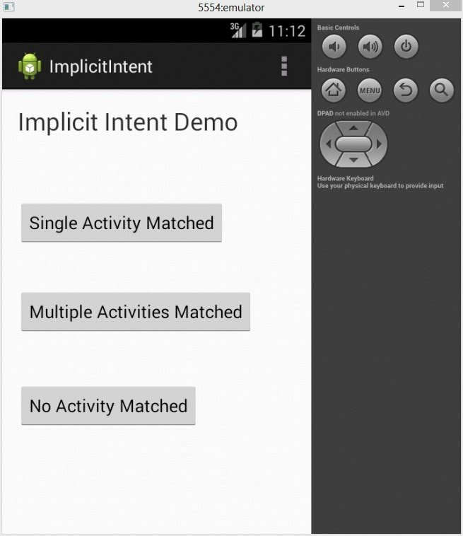
Demo
Save and run this app.
In the first screen, there are three buttons.

Slide 64
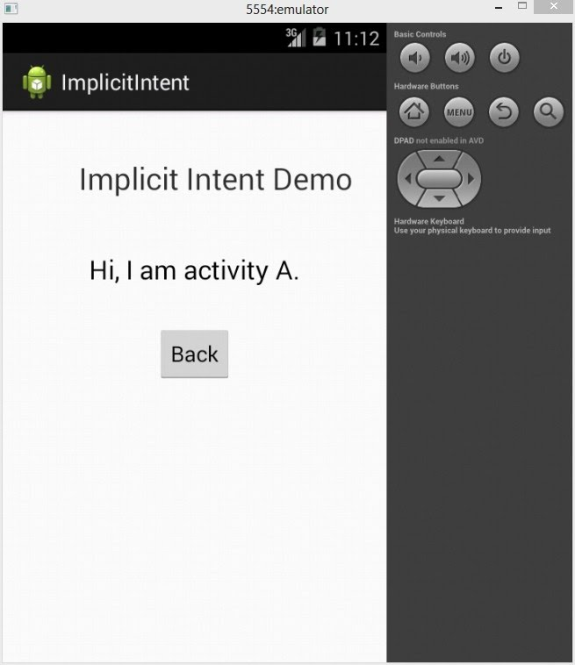
When clicking the first button, only one activities is matched. In our lab, only ActivityA matches this intent.

Slide 65
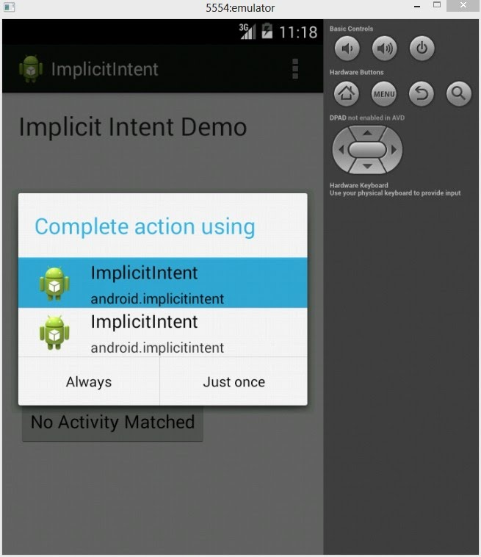
When clicking the second button, both Activity B and C are matched. So, the Android system would show a dialog for user to choose one of the activity to start.

Slide 66
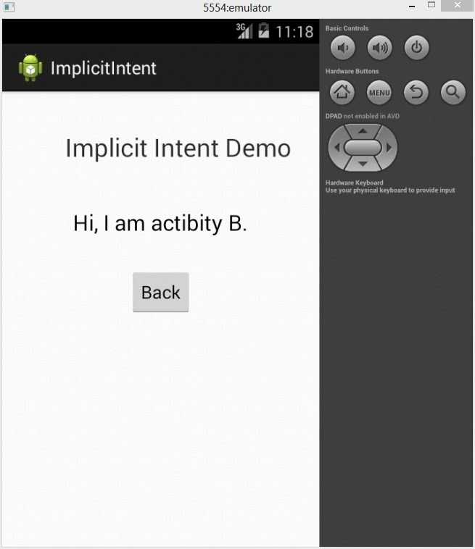
In the screenshot above, we can see there are two Apps showed in the dialog. Both of them named as ImplicitIntent (the name of our project), it is because the activities that match this intent are in the same app.
If we choose the first one, it will start ActivityB.

Slide 67
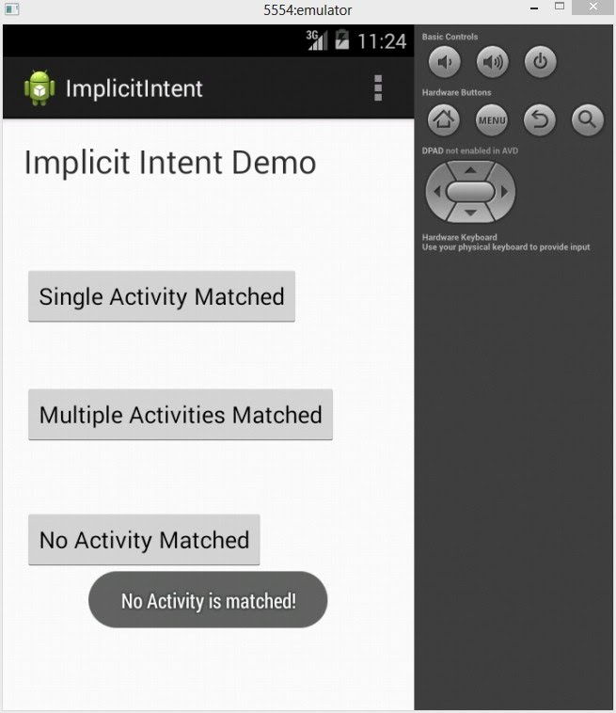
There is no activity that is matched with any intent.

Slide 68
Resources:
http://developer.android.com/guide/components/intents-filters.html

